Slide 1
Telecom Customer
Churn analysis

Slide 2
· TABLE OF CONTENTS ·
01
02
03
04
Introduction
Goals and KPI
Recommended Analysis
Conclusion

Slide 3

01
· Problem & Background ·
The fictional telecommunications company, serving 7,043 customers in California, faces significant customer churn. The dataset includes customer demographics, location, services, and churn status. However, poor data quality, such as inconsistencies and missing values, could hinder accurate analysis and decision-making. Improving data quality is essential to better understanding churn drivers and developing effective retention strategies.

Slide 4
· Goals ·
Reduce customer churn by analyzing key dissatisfaction drivers and improving service quality. The focus is on enhancing customer support and addressing pain points to increase long-term retention.

Slide 5
· KPI’S ·
Total Revenue
Total Cities
Total Churned
Total Customer
Average Charges
2,13,71,132
2212
1869
3166
2280

Slide 6
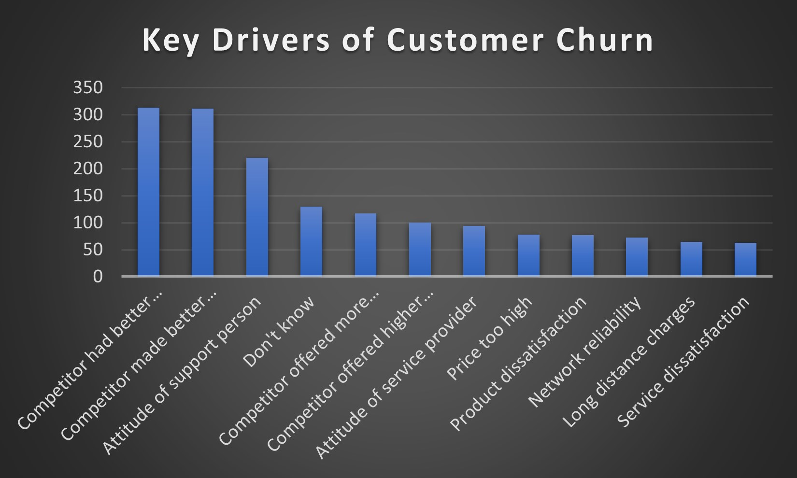
· Recommended Analysis ·
Q1. What seems to be the key drivers of customer churn?

Slide 7
· Recommended Analysis ·
Q2. Is the company losing high-value customers?If so, how can they retain them?
Match Competitor Offers: Provide better devices, pricing, and data limits to attract high-value customers.
Improve Customer Service: Train support teams and assign account managers for personalized care.
Loyalty Programs: Offer exclusive deals and early upgrades to reward loyal customers.
Enhance Product Quality: Boost network reliability and product performance to reduce issues.
Flexible Pricing: Offer tiered pricing to suit different customer budgets.

Slide 8
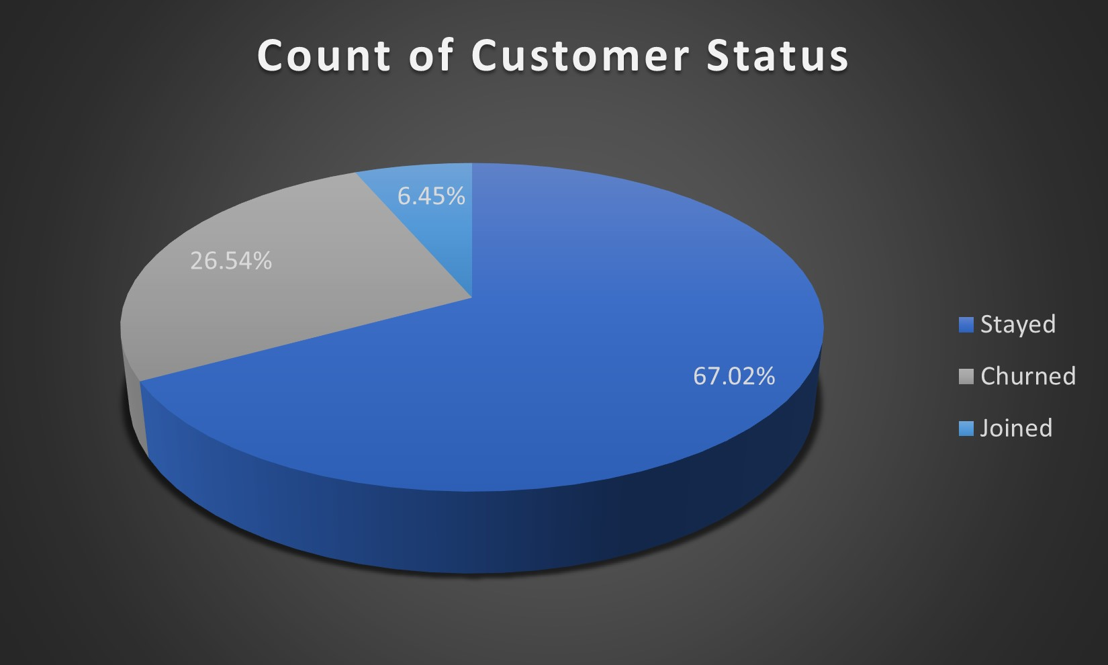
· Recommended Analysis ·
Q3. Out of the 3 customer statuses, stayed, churned, and joined, which has the highest %?

Slide 9
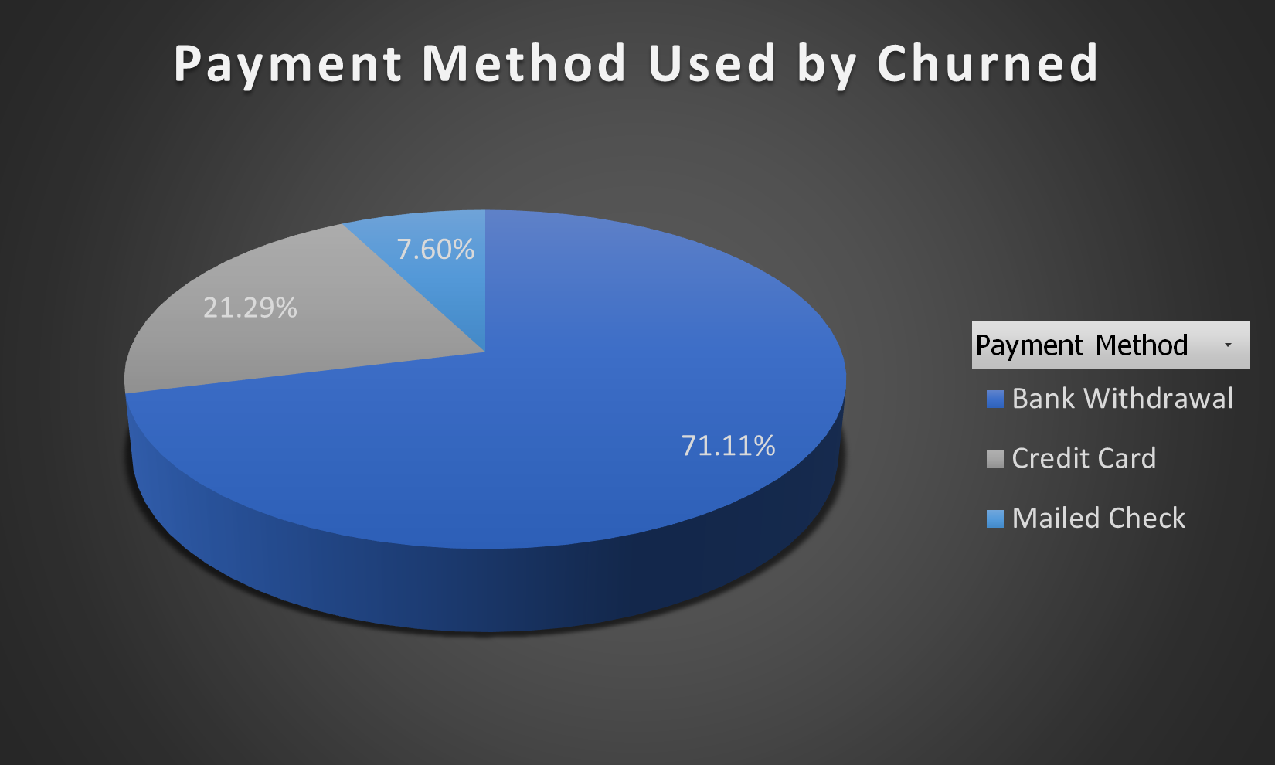
· Recommended Analysis ·
Q4. What payment method was preferred by churned users?

Slide 10
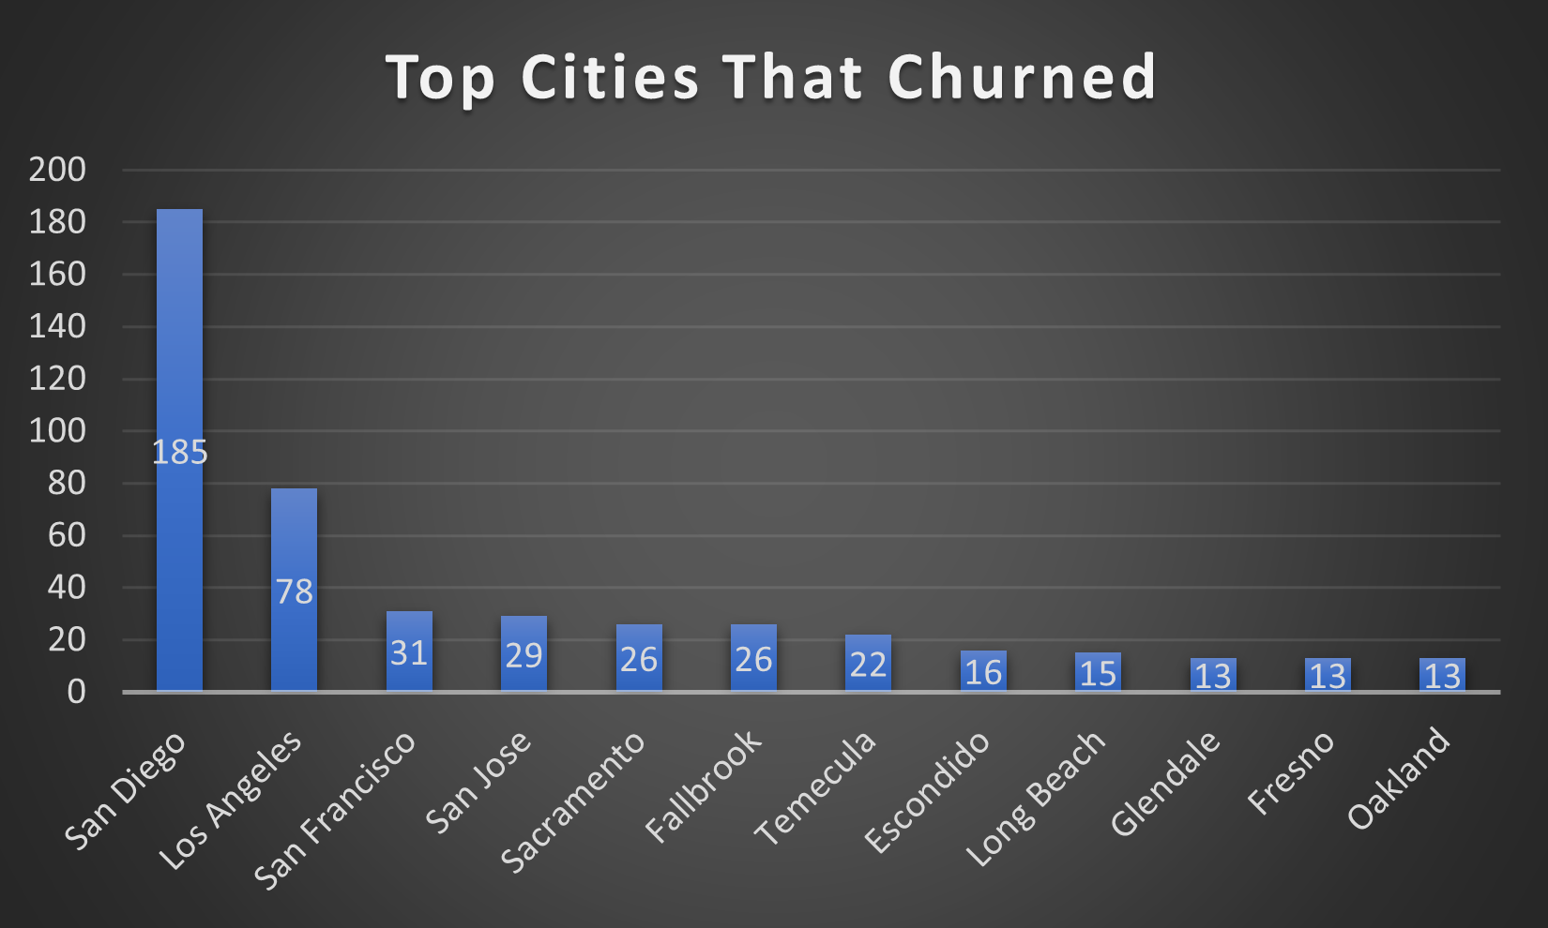
· Recommended Analysis ·
Q5. What are the top 12 cities that churned?

Slide 11
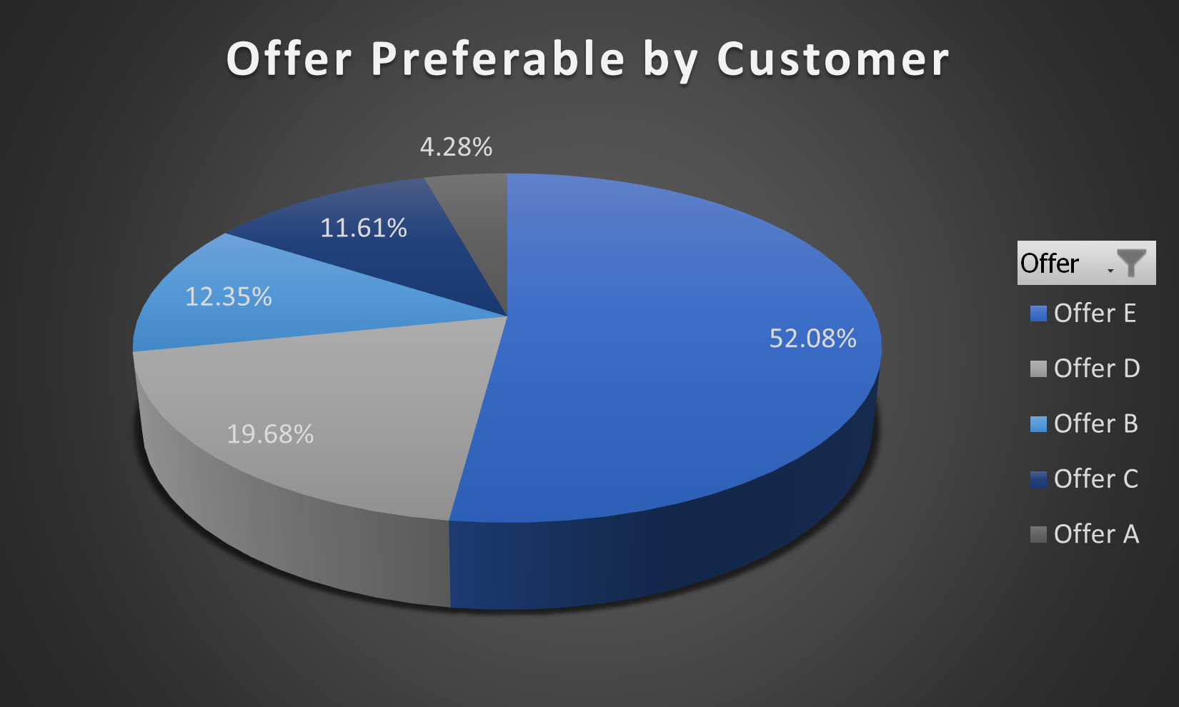
· Recommended Analysis ·
Q6. What churn offers were preferable by the customers?

Slide 12
· Conclusion ·
By improving data quality and understanding churn patterns, the telecom company can effectively reduce churn and boost retention. Key strategies like offering competitive deals, enhancing customer service, and implementing loyalty programs, combined with product improvements and flexible pricing, will strengthen customer satisfaction and drive long-term growth.

Slide 13
· Thankyou ·
Contact Details -
Name: Kunal Malviya
Linkedin: https://www.linkedin.com/in/kunalmalviya06
Portfolio: https://peerlist.io/kunalmalviya06
Discord: KunalMalviya06

